Slide 1

Neil Yetz, MPH Candidate Colorado School Of Public Health
An Analysis of the Social Network of Campus Connections and its Relationship to Youth Outcomes

Slide 2
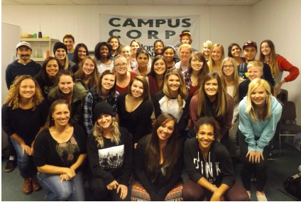
The Campus Connections Program
12 week Mentorship program open to all majors/years at Colorado State University.
Colorado State University (CSU) Students mentor at-risk youth (11-18 yrs) referred from the juvenile justice system, schools, human services.
Facilitated my experienced program staff and Marriage & Family Therapist graduate students.
Mentors are paired 1:1 with youth and work both individually and in multidisciplinary teams.

Slide 3
Mentoring At-Risk Youth
DuBois DL, Portillo N, Rhodes JE, Silverthorn N & Valentine (2011). How effective are mentoring programs for youth? A systematic assessment of the
Past meta-analytic reviews show evidence for better outcomes for youth that partake in mentorship programs^{1,2}
Mentored at-risk youth are 55% more likely to attend college than their non-mentored at-risk peers³
Group based mentoring programs have the added benefit of serving more at-risk youth and saving costs in comparison to one on one programs¹
1 (Dubois et al, 2011)
2 Tolan et al, 2013)
3 (Thurlow, Sinclair & Johnson, 2002)

Slide 4
Objective
To Understand the role of the social network on adolescent depression at the end of the Campus Connections Program.

Slide 5
Hypothesis
Adolescent mentee participants in the Campus Connections Program who have higher degrees of inbound centrality, outbound centrality, and reciprocity will demonstrate more improvement in measured depression outcomes from program start to program end.

Slide 6
Methods
5 surveys distributed across 11 week program period
Surveys distributed at week s 1, 3, 6, 9, & 11
Assessed the social network ties and bonds across all weeks of all program participants.
Mentee demographic information assessed
Outcome measures of depression using the Center for Epidemiologic Studies Depression Scale (CES-D) ⁴
Assessed at Baseline and Week 11
Reliability: α = 0.92
4 (Haroz, Ybarra & Eaton, 2014)

Slide 7
Mentee Characteristics
Total Mentees | 83
% Male | 65%
Mean Age (SD) [Range 11-18] | 14 (1.89)
Depression Mean (SD) [CES-D; Score 0-7] | Baseline: 1.63 (1.70)
 | Post: 1.42 (1.58)
Race % | White = 62.07%
 | Hispanic = 18.39%
 | Other = 19.54%

Slide 8
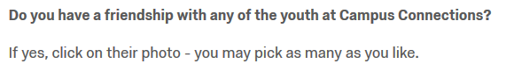



Assessing network ties and bonds

Slide 9

Assessing network ties and bonds

Slide 10
Assessing network ties and bonds

Slide 11

Assessing network ties and bonds

Slide 12
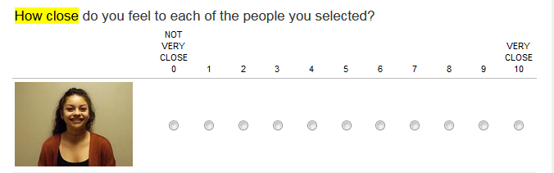

Assessing network ties and bonds

Slide 13
Assessing network ties and bonds

Slide 14
Social Network Analysis: A Quick Overview

Slide 15
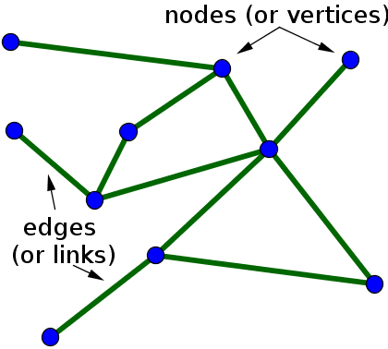
Social Network Analysis (SNA)
The investigation of social structures and bonds within a population.
Key terms:
Density
Centralization
Reciprocity

Slide 16
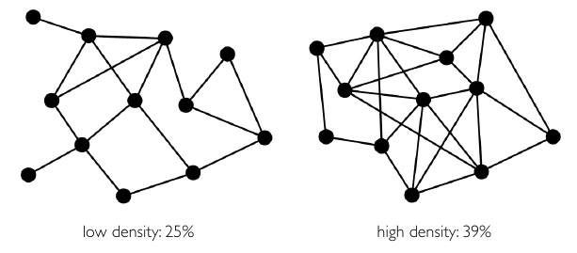
Social Network Analysis (SNA)
Key terms:
Density – The Number of network ties, expressed as a percentage of the number of ordered/unordered pairs

Slide 17
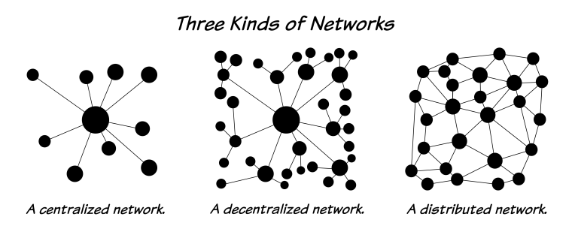
Social Network Analysis (SNA)
Key terms:
Centralization – an identifier position in the graph through inbound and outbound relationships

Slide 18
Social Network Analysis (SNA)
Key terms:
Reciprocity – a measure of reciprocated links in a directed network
Not
Reciprocated
Reciprocated

Slide 19
Social Network Analysis (SNA)
The investigation of social structures and bonds within a population.
Key terms:
Density – A proportion of connections as compared to the theoretical max in that specific network
Centralization – an identifier of influence and position in the graph through inbound and outbound relationships
Reciprocity – a measure of reciprocated links in a directed network

Slide 20
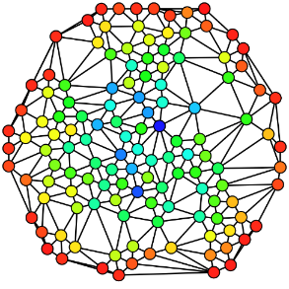
The Campus Connections Social Network

Slide 21
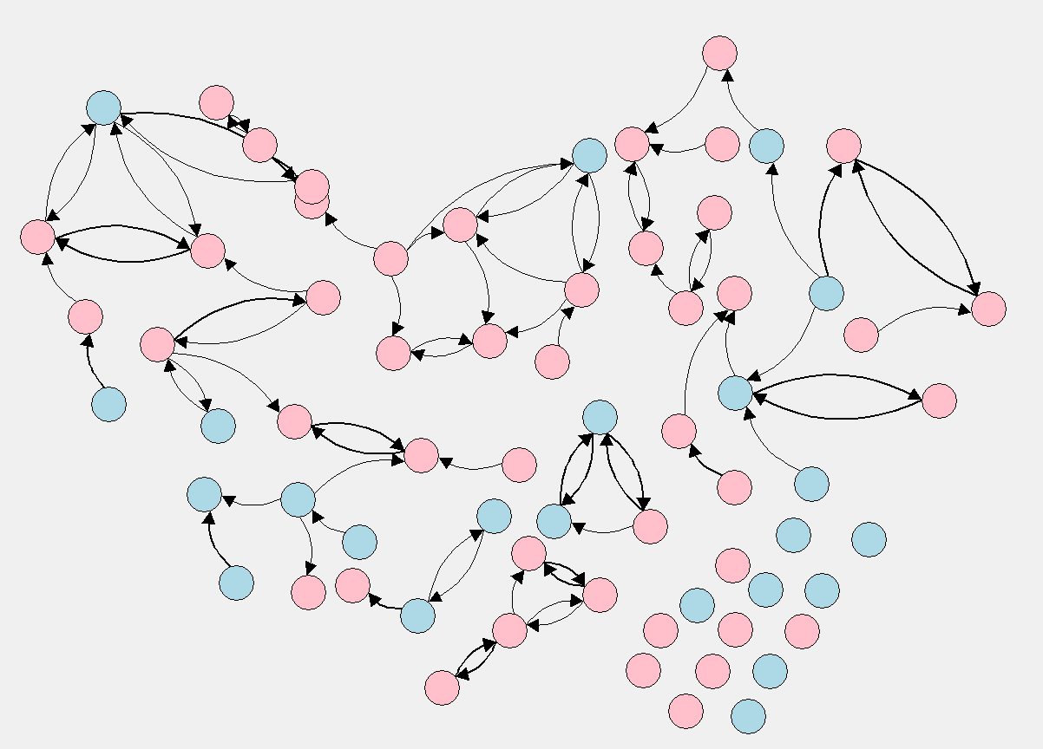
The Growing Social Network
Week | Density | Centrality | Reciprocity
1 (Baseline) | 0.02 | 0.05 | 0.43
N = 68

Slide 22
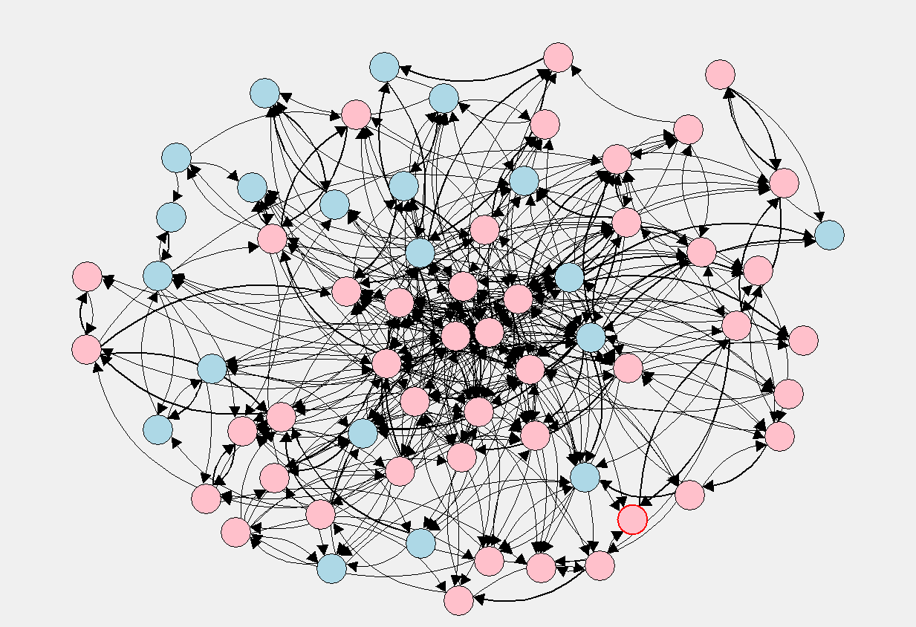
The Growing Social Network
Week | Density | Centrality | Reciprocity
1 (Baseline) | 0.02 | 0.05 | 0.43
3 | 0.11 | 0.16 | 0.44
N = 64

Slide 23
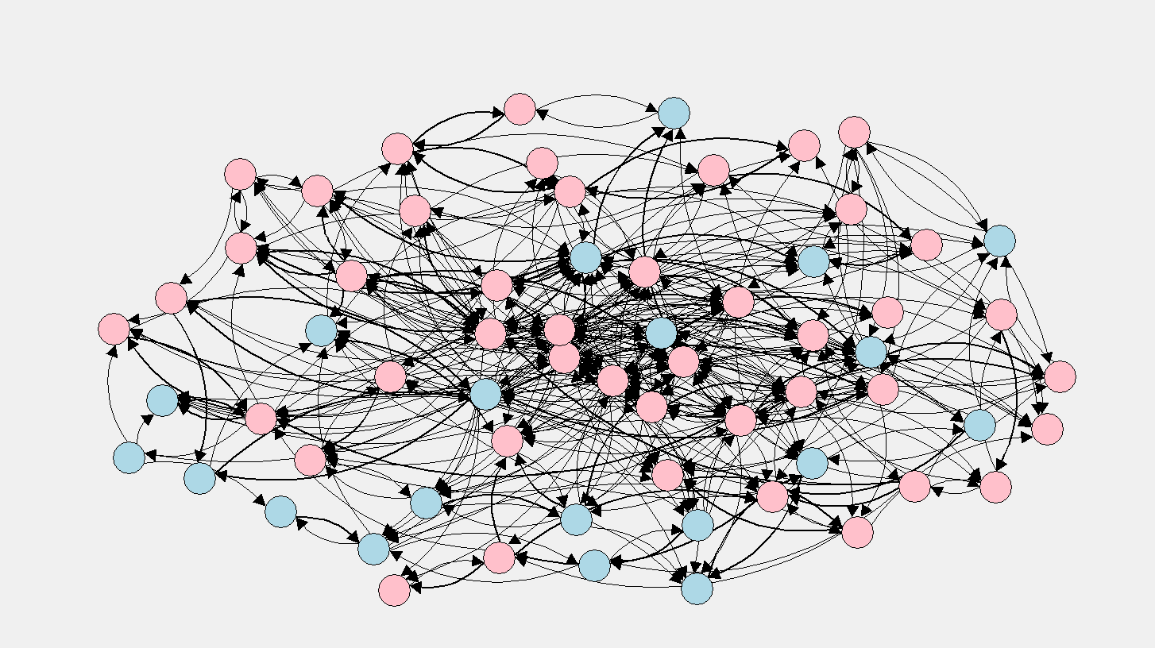
The Growing Social Network
Week | Density | Centrality | Reciprocity
1 (Baseline) | 0.02 | 0.05 | 0.43
3 | 0.11 | 0.16 | 0.44
6 | 0.18 | 0.17 | 0.50
N = 61

Slide 24
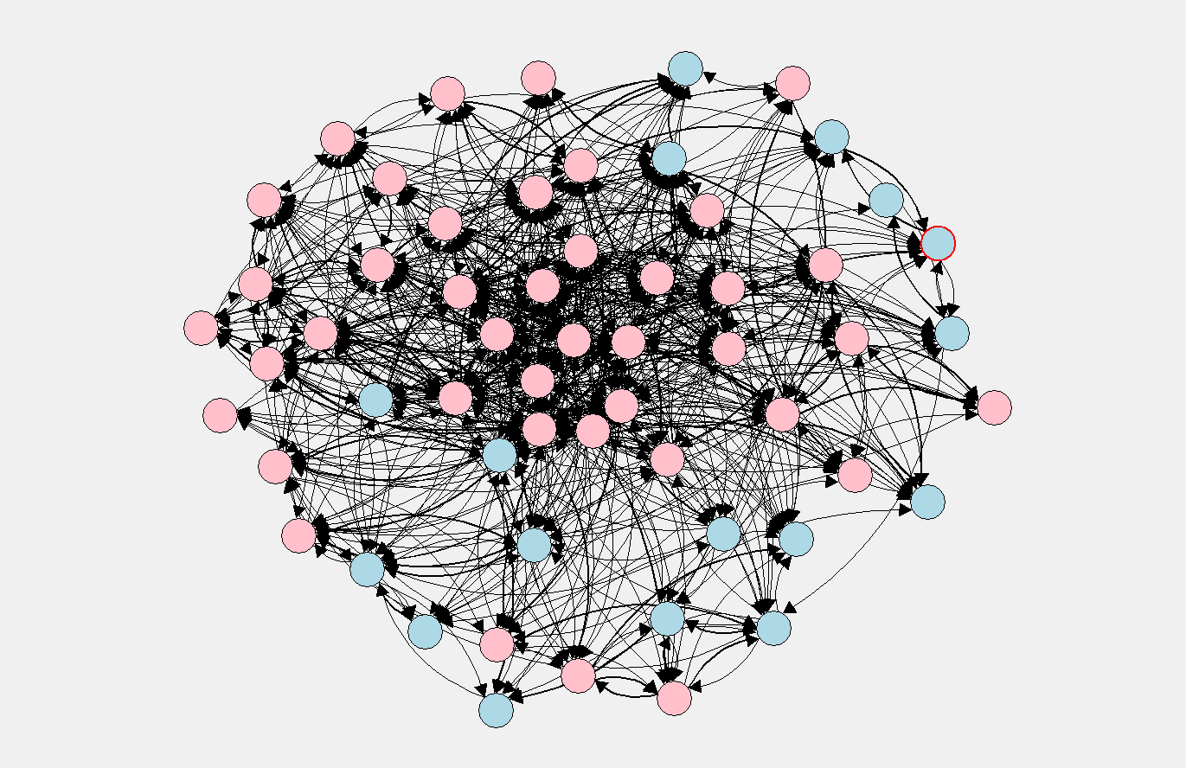
The Growing Social Network
Week | Density | Centrality | Reciprocity
1 (Baseline) | 0.02 | 0.05 | 0.43
3 | 0.11 | 0.16 | 0.44
6 | 0.18 | 0.17 | 0.50
9 | 0.23 | 0.17 | 0.47
N = 58

Slide 25
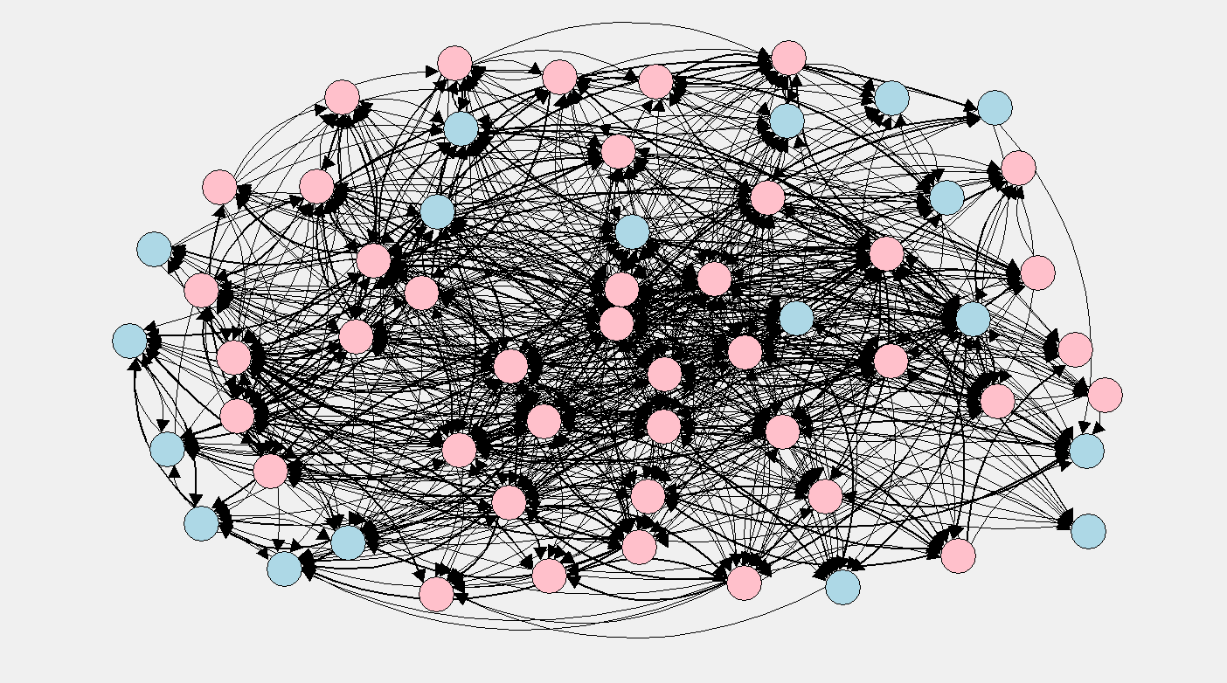
The Growing Social Network
Week | Density | Centrality | Reciprocity
1 (Baseline) | 0.02 | 0.05 | 0.43
3 | 0.11 | 0.16 | 0.44
6 | 0.18 | 0.17 | 0.50
9 | 0.23 | 0.17 | 0.47
11 | 0.25 | 0.20 | 0.49
N = 59

Slide 26
Analysis Methods
Linear Regression was used to assess the association between network connections and youth outcomes across four sessions during the Fall 2015 and Spring 2016 CC sessions.
Controlled for baseline depression and important control variables.
All network measures were standardized to be compared across different the 4 assessed sessions.
This study used hierarchical regression modeling to assess the addition of the social network measures at week 9 in a predictive model for mentee depression at week 11.

Slide 27
Results

Slide 28
Model Comparison (N=83)
Reduced Model |  |  |  | Full Model
Variable | Estimate | 95% CI |  | Variable | Estimate | 95% CI
Baseline Depression | 0.54 | [0.39 – 0.69] |  | Baseline Depression | 0.54 | [0.39-0.69]
Age | 0.17 | [0.04 – 0.30] |  | Age | 0.15 | [0.03-0.29]
Sex | -0.41 | [-0.91 – 0.09] |  | Sex | -0.40 | [-0.92-0.13]
Race |  |  |  | Race
White | Reference | Reference |  | White | Reference | Reference
Hispanic | -0.57 | [-1.25 – 0.11] |  | Hispanic | -0.76 | [-1.45 - 0.08]
Other | -0.03 | [-0.55 – 0.71] |  | Other | 0.05 | [-0.58 - 0.68]
Night |  |  |  | Night
Monday | Reference |  | Reference | Monday | Reference | Reference
Tuesday | 0.50 |  | [-0.24 – 1.24] | Tuesday | 0.52 | [-0.24 - 1.28]
Wednesday | 0.08 |  | [-0.66 – 0.60] | Wednesday | 0.16 | [-0.51 - 0.84]
 |  |  |  | Inbound Centrality | -4.42 | [-13.78 - 4.95]
 |  |  |  | Outbound Centrality | -0.93 | [-3.27 - 1.41]
 |  |  |  | Reciprocity | -19.33 | [-32.54 - 6.11]
 |  |  |  | Inbound Centrality * Reciprocity | 251.25 | [90.20 - 412.3]
Reduced Model R² = 0.55 |  |  |  | 12% increase in explained variance in post intervention depression
Full Model R² = 0.62

Slide 29
Model Comparison (N=83)
Reduced Model |  |  |  | Full Model
Variable | Estimate | 95% CI |  | Variable | Estimate | 95% CI
Baseline Depression | 0.54 | [0.39 – 0.69] |  | Baseline Depression | 0.54 | [0.39-0.69]
Age | 0.17 | [0.04 – 0.30] |  | Age | 0.15 | [0.03-0.29]
Sex | -0.41 | [-0.91 – 0.09] |  | Sex | -0.40 | [-0.92-0.13]
Race |  |  |  | Race
White | Reference | Reference |  | White | Reference | Reference
Hispanic | -0.57 | [-1.25 – 0.11] |  | Hispanic | -0.76 | [-1.45 - 0.08]
Other | -0.03 | [-0.55 – 0.71] |  | Other | 0.05 | [-0.58 - 0.68]
Night |  |  |  | Night
Monday | Reference |  | Reference | Monday | Reference | Reference
Tuesday | 0.50 |  | [-0.24 – 1.24] | Tuesday | 0.52 | [-0.24 - 1.28]
Wednesday | 0.08 |  | [-0.66 – 0.60] | Wednesday | 0.16 | [-0.51 - 0.84]
 |  |  |  | Inbound Centrality | -4.42 | [-13.78 - 4.95]
 |  |  |  | Outbound Centrality | -0.93 | [-3.27 - 1.41]
 |  |  |  | Reciprocity | -19.33 | [-32.54 - 6.11]
 |  |  |  | Inbound Centrality * Reciprocity | 251.25 | [90.20 - 412.3]
Reduced Model R² = 0.55 |  |  |  | 12% increase in explained variance in post intervention depression
Full Model R² = 0.62

Slide 30
Model Comparison (N=83)
Reduced Model |  |  |  | Full Model
Variable | Estimate | 95% CI |  | Variable | Estimate | 95% CI
Baseline Depression | 0.54 | [0.39 – 0.69] |  | Baseline Depression | 0.54 | [0.39-0.69]
Age | 0.17 | [0.04 – 0.30] |  | Age | 0.15 | [0.03-0.29]
Sex | -0.41 | [-0.91 – 0.09] |  | Sex | -0.40 | [-0.92-0.13]
Race |  |  |  | Race
White | Reference | Reference |  | White | Reference | Reference
Hispanic | -0.57 | [-1.25 – 0.11] |  | Hispanic | -0.76 | [-1.45 - 0.08]
Other | -0.03 | [-0.55 – 0.71] |  | Other | 0.05 | [-0.58 - 0.68]
Night |  |  |  | Night
Monday | Reference |  | Reference | Monday | Reference | Reference
Tuesday | 0.50 |  | [-0.24 – 1.24] | Tuesday | 0.52 | [-0.24 - 1.28]
Wednesday | 0.08 |  | [-0.66 – 0.60] | Wednesday | 0.16 | [-0.51 - 0.84]
 |  |  |  | Inbound Centrality | -4.42 | [-13.78 - 4.95]
 |  |  |  | Outbound Centrality | -0.93 | [-3.27 - 1.41]
 |  |  |  | Reciprocity | -19.33 | [-32.54 - 6.11]
 |  |  |  | Inbound Centrality * Reciprocity | 251.25 | [90.20 - 412.3]
Reduced Model R² = 0.55 |  |  |  | 12% increase in explained variance in post intervention depression
Full Model R² = 0.62

Slide 31
Model Comparison (N=83)
Reduced Model |  |  |  | Full Model
Variable | Estimate | 95% CI |  | Variable | Estimate | 95% CI
Baseline Depression | 0.54 | [0.39 – 0.69] |  | Baseline Depression | 0.54 | [0.39-0.69]
Age | 0.17 | [0.04 – 0.30] |  | Age | 0.15 | [0.03-0.29]
Sex | -0.41 | [-0.91 – 0.09] |  | Sex | -0.40 | [-0.92-0.13]
Race |  |  |  | Race
White | Reference | Reference |  | White | Reference | Reference
Hispanic | -0.57 | [-1.25 – 0.11] |  | Hispanic | -0.76 | [-1.45 - 0.08]
Other | -0.03 | [-0.55 – 0.71] |  | Other | 0.05 | [-0.58 - 0.68]
Night |  |  |  | Night
Monday | Reference |  | Reference | Monday | Reference | Reference
Tuesday | 0.50 |  | [-0.24 – 1.24] | Tuesday | 0.52 | [-0.24 - 1.28]
Wednesday | 0.08 |  | [-0.66 – 0.60] | Wednesday | 0.16 | [-0.51 - 0.84]
 |  |  |  | Inbound Centrality | -4.42 | [-13.78 - 4.95]
 |  |  |  | Outbound Centrality | -0.93 | [-3.27 - 1.41]
 |  |  |  | Reciprocity | -19.33 | [-32.54 - 6.11]
 |  |  |  | Inbound Centrality * Reciprocity | 251.25 | [90.20 - 412.3]
Reduced Model R² = 0.55 |  |  |  | 12% increase in explained variance in post intervention depression
Full Model R² = 0.62

Slide 32
Model Comparison (N=83)
Reduced Model |  |  |  | Full Model
Variable | Estimate | 95% CI |  | Variable | Estimate | 95% CI
Baseline Depression | 0.54 | [0.39 – 0.69] |  | Baseline Depression | 0.54 | [0.39-0.69]
Age | 0.17 | [0.04 – 0.30] |  | Age | 0.15 | [0.03-0.29]
Sex | -0.41 | [-0.91 – 0.09] |  | Sex | -0.40 | [-0.92-0.13]
Race |  |  |  | Race
White | Reference | Reference |  | White | Reference | Reference
Hispanic | -0.57 | [-1.25 – 0.11] |  | Hispanic | -0.76 | [-1.45 - 0.08]
Other | -0.03 | [-0.55 – 0.71] |  | Other | 0.05 | [-0.58 - 0.68]
Night |  |  |  | Night
Monday | Reference |  | Reference | Monday | Reference | Reference
Tuesday | 0.50 |  | [-0.24 – 1.24] | Tuesday | 0.52 | [-0.24 - 1.28]
Wednesday | 0.08 |  | [-0.66 – 0.60] | Wednesday | 0.16 | [-0.51 - 0.84]
 |  |  |  | Inbound Centrality | -4.42 | [-13.78 - 4.95]
 |  |  |  | Outbound Centrality | -0.93 | [-3.27 - 1.41]
 |  |  |  | Reciprocity | -19.33 | [-32.54 - 6.11]
 |  |  |  | Inbound Centrality * Reciprocity | 251.25 | [90.20 - 412.3]
Reduced Model R² = 0.55 |  |  |  | 12% increase in explained variance in post intervention depression
Full Model R² = 0.62

Slide 33
Results Main Finding
Partial F(4, 71) = 2.89, p = 0.028
The full model including the social network measures explains significantly more variability in depression scores than the reduced model.

Slide 34
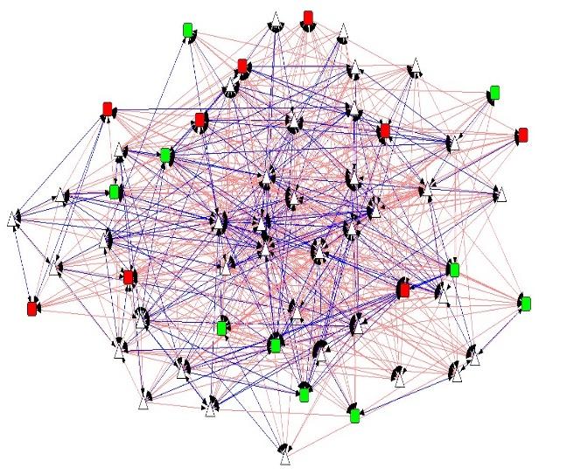
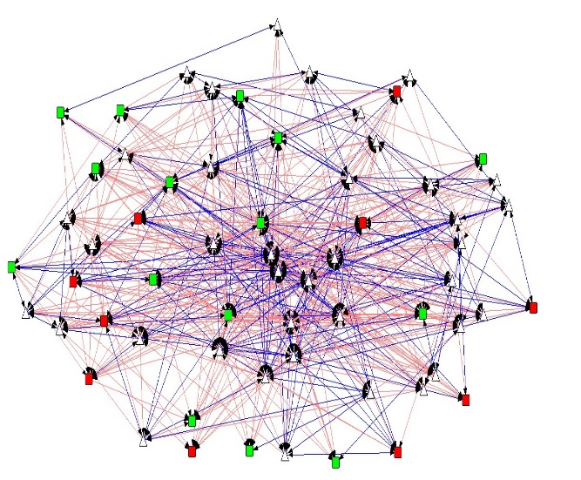
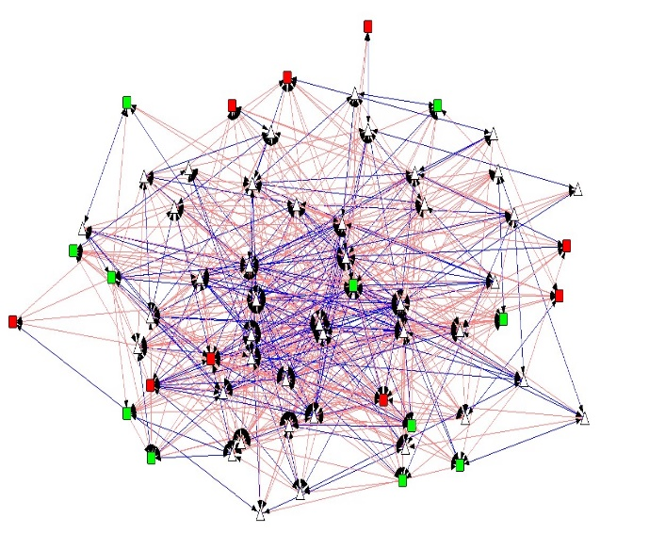
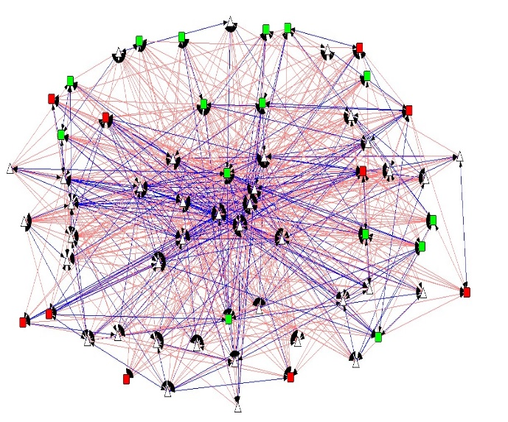
The Four Assessed Networks
Legend
= Depressed Mentee
= Non-Depressed Mentee
Density = 0.23 | Reciprocity = 0.47
Density = 0.21 | Reciprocity = 0.53
= Staff Member
= Reciprocated Tie
= Non-Reciprocated Tie
Density = 0.21 | Reciprocity = 0.50
Density = 0.18 | Reciprocity = 0.48

Slide 35
Legend
= Depressed Mentee
= Non-Depressed Mentee
= Staff Member
= Reciprocated Tie
= Non-Reciprocated Tie

Slide 36
Conclusions
In sum, social network measures of inbound & outbound centrality, and reciprocity serve as significant explanatory variables in a regression model when compared to a reduced model with basic predictors.
Social bonds and friendships may serve as important factors understanding in program success.

Slide 37
Implications
Providing a better understanding of social network connections in a youth mentoring program
Encouraging a more and stronger relationships within Campus Connections

Slide 38
Limitations and Future Research
Limitations
Program attrition and drop out
Small sample size
Preliminary analysis
Future Research
Further understanding of which aspects of a mentor-mentee relationship are most important
E.g, mentee-mentee relationship vs. mentor-mentee relationships.

Slide 39
THANK YOU!
Campus Connections program staff
Stacy Biggerstaff, Gereon Fredrickson, Mackenzie Miller
HDFS Faculty
Dr. Shelly Haddock
Capstone Academic Advisor
Dr. Tracy Nelson
Capstone Preceptor & Mentor
Dr. Kimberly Henry
All CSPH Faculty, Staff, and Peers

Slide 40
REFERENCES

Slide 41
EXTRA SLIDES
Do not go past this

Slide 42
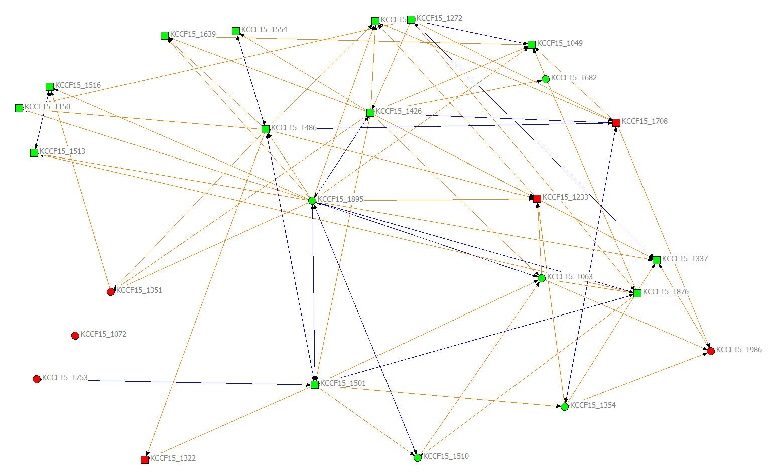
Adolescent Specific Social Network

Slide 43
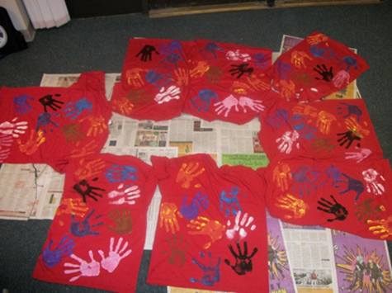
Program Evaluation Findings
Participation in Campus Corps accounted for significant changes:
Community Service Self-Efficacy
Service Learning Benefit
Self-Esteem
Civic Attitudes
Political Awareness
Civic Action
Interpersonal Social Skills

Slide 44
SNA, Mentorship, and Adolescents
Adolescent social groups tied with peer deviance and substance use (Ryzin & Dishion, 2014)
Adolescents that reported having a mentoring relationship reported more favorable life outcomes (National Longitudinal study of Adolescents; Dubois & Silverthorn, 2005)
Previous research suggest positive relationships serve as a protective factor for youth (Kawachi & Berkman, 2001)

Slide 45
Student experiences
“I was ready to drop out of college before joining Campus Corps and now, because of my time spent with the youth, I am excited about the possibility of pursuing an education degree.”
“I graduated over a year ago and Campus Corps was the most meaningful and rewarding part of my college career.”
“[In Campus Corps] I gained a whole family and a place to belong at CSU.”

Slide 46
Background
2009:
Rates of youth involved in the juvenile justice system increased dramatically during the economic recession
District Attorney & Juvenile Magistrate asked for creative solutions
Research based design – best practices in mentoring
Federal funding to launch program ($500,000 - CNCS grant)
2010:
Launched two sections – Spring 2010
Mentors from only four majors (HDFS, HES, Psych, Spanish)
Expanded to include students from all major and all years at CSU due to student demand

Slide 47
For more information, please contact:
Jen Krafchick, PhD, CFLE
Assistant Professor
Human Development and Family Studies
jen.krafchick@colostate.edu
970-491-2171
Visit us online:
http://www.hdfs.chhs.colostate.edu/students/undergraduate/campuscorps/

Slide 48

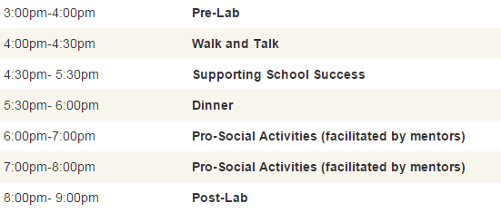
Campus Connections Schedule

Slide 49
Campus Connections
2010-2015:
Four sections every fall/spring + two summers
Approximately 32 mentoring pairs per section
Over 2,000 CSU students have participated
Over 1,700 at-risk youth have participated
CSU students from over 90 different majors
William T. Grant Foundation 3 year funding ($580,000)
Notes:
The coefficients and odds ratios for all of the model’s covariates are provided in Appendix B. Odds ratios can be difficult to interpret in a practical sense; therefore, figures 1 and 2 graph the model’s predicted probability of graduating for a CC new freshman and transfer student compared to a non-CC peer assuming all other things are equal over six years of enrollment.

Slide 50
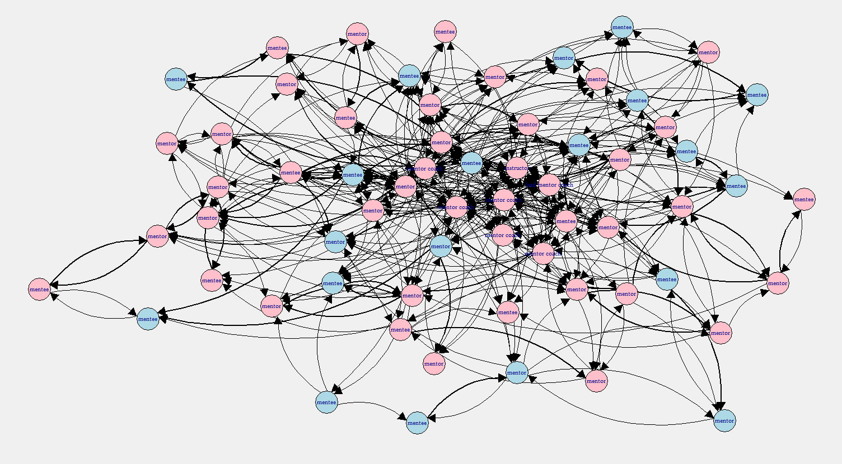
The Growing Social Network
Week 3
Density: 0.11
Centrality: 0.16
Reciprocity: 0.44
= Staff(when pres complete)

Slide 51
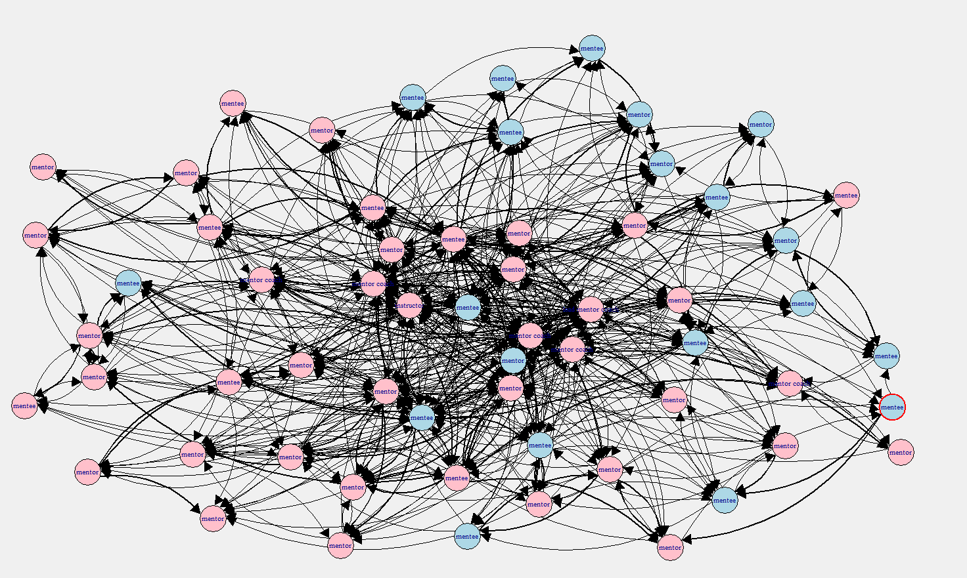
The Growing Social Network
Week 6
Density: 0.18
Centrality: 0.17
Reciprocity: 0.50
= Staff(when pres complete)

Slide 52
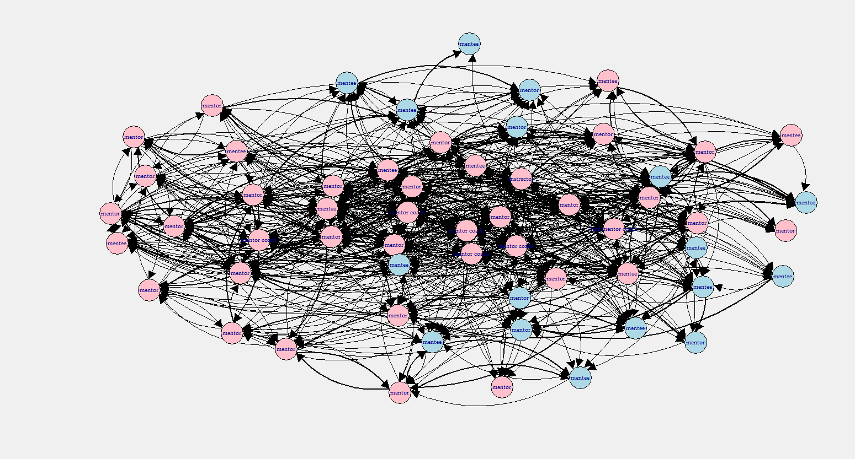
The Growing Social Network
Week 9
Density: 0.18
Cenrality: 0.17
Reciprocity: 0.50
= Staff(when pres complete)

Slide 53
Results
N= 83
Reduced model:
Post-Depression = Standard Control explanatory variables: Age, sex, attendance night, baseline depression, ethnicity
R² = 0.51
Full Model:
Post-Depression = Reduced model with the addition measures of individual level inbound/outbound centrality and individual reciprocity.
R² = 0.59

Slide 54
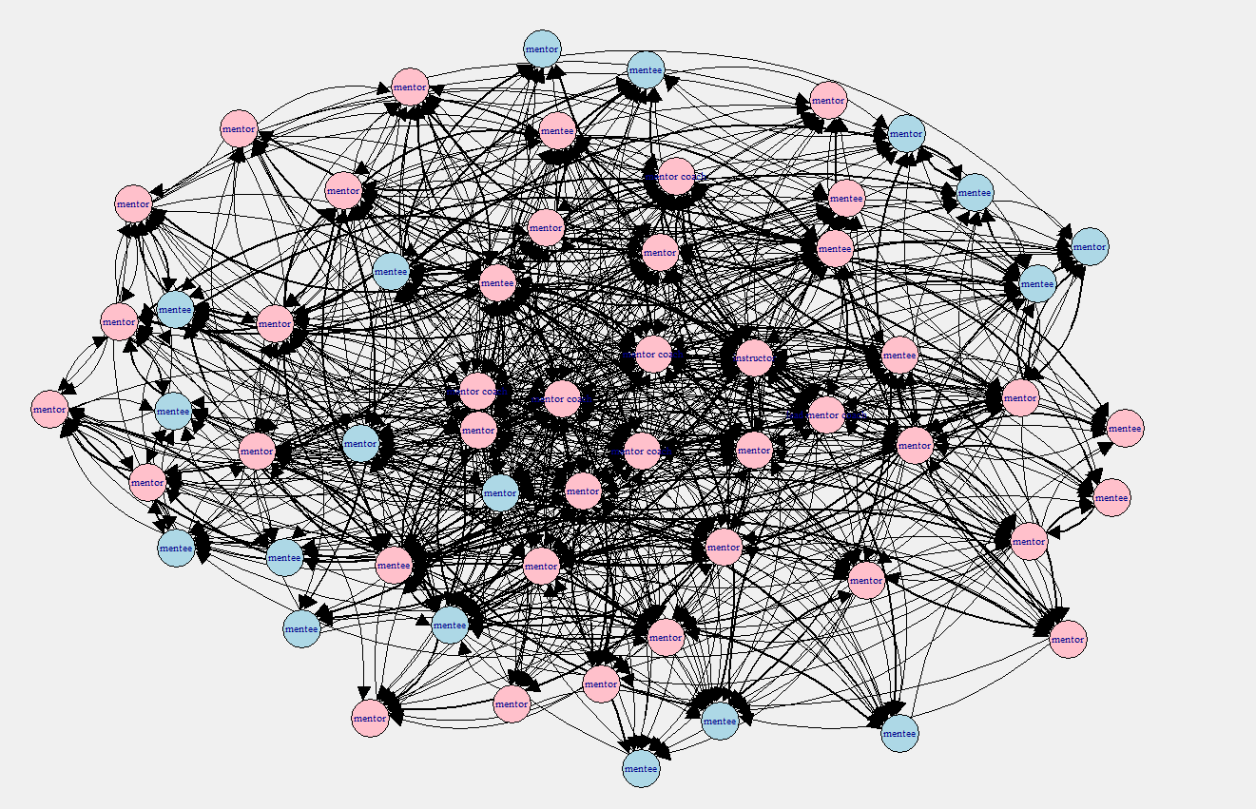
The Growing Social Network
Week 11
Density: 0.25
Centrality: 0.20
Reciprocity: 0.49
= Staff(when pres complete)

